Slide 1



Lecture on: CRISP - DM and Business Problem Solving
Notes:
Until now, you have learnt the basic functionalities of Excel.
Going ahead, we will solve data science case studies in Excel. To do that, we need to know the following:
What exactly is Data Science?
How do you solve a problem using Data Science?
Let’s start with understanding what is Data Science.

Slide 2
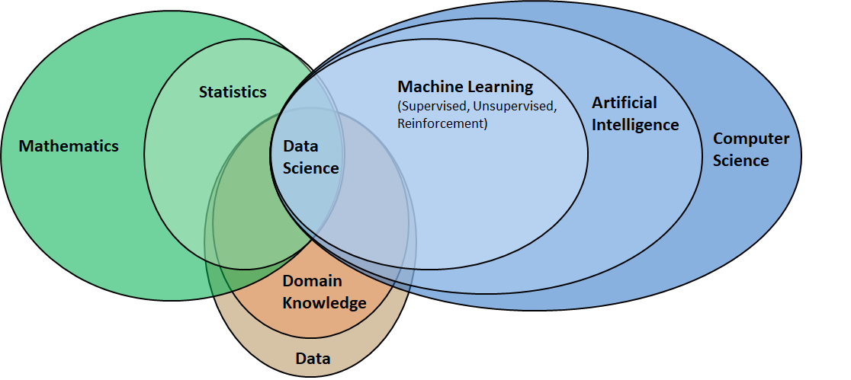
Understanding Data Science
Notes:
Data Science is the study or science of data. It is about extracting, analyzing, visualizing, managing and storing data to create insights. These insights help the companies to make powerful data-driven decisions.
Data Science is multidisciplinary: (Use examples to drive the following)
Domain knowledge and it’s data because you are solving a problem in a domain or industry
Statistics and Mathematics to analyse data (simple analysis like sales trend, pie chart distribution of different channel of sales, which types of users are growing on Netlfix, etc)
Computer Science or Programming to do analysis and modelling on large scale or to automate the process
Now, let’s briefly understand the evolution of data science.

Slide 3
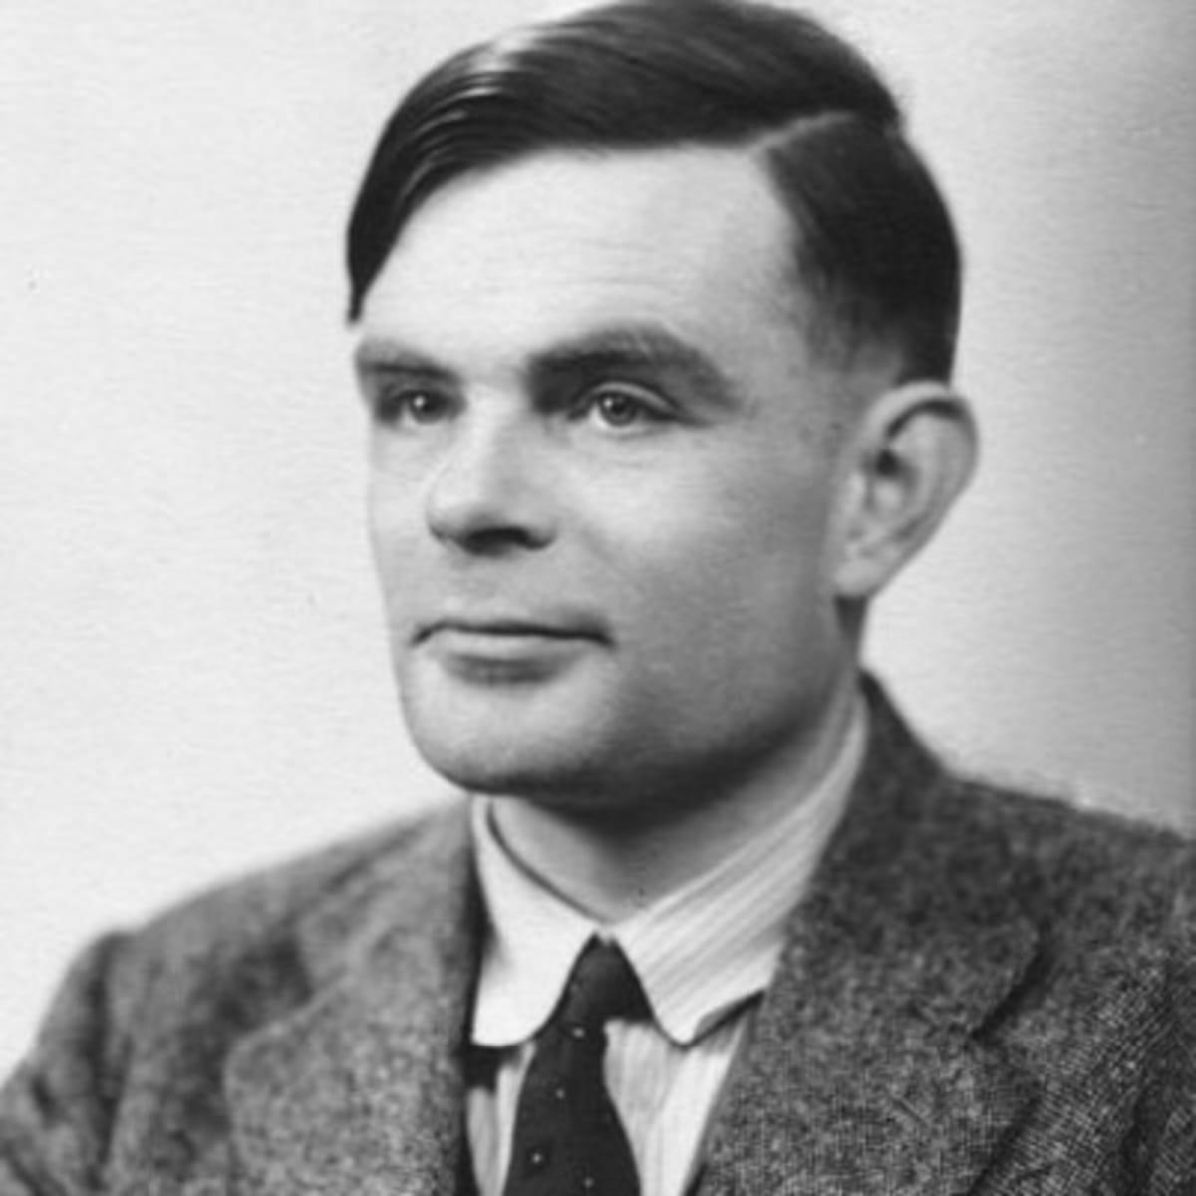
Major Breakthroughs in Data Science
Alan Turing
1950
Father of Computer Science and Artificial Intelligence
1936-Turing Machine
1950- Turing Test
Notes:
Alan Turing, a British mathematician and code breaker is often considered to be the father of computer science and artificial intelligence. He developed the Turing machine in 1936. This was a model that could use some predefined set of rules to determine an outcome from a set of input variables.
Fourteen years later, Alan Turing then introduced the Turing Test. This is also famous by the name of Imitation Games a movie created to show the brilliant thinking behind the Turing machine. The Turing Machine is considered to be the first attempt to measure if machines can be defined as intelligent. According to Turing, a machine could be perceived as intelligent, if it could mimic human behavior under specific conditions.

Slide 4
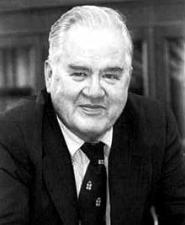
Major Breakthroughs in Data Science
Alan Turing
1962
1950
John W. Tukey
1962 paper on “The Future of Data Analysis
Evolvement of statistics and need for data analysis”
Notes:
John Wilder Tukey (1915–2000) was an American mathematician and statistician who significantly influenced the field of data analysis and statistics.
Introduced Box Plot in 1977 book "Exploratory Data Analysis", a philosophy and set of techniques that emphasize the importance of looking at data to find patterns and hypotheses before formulating a specific statistical model or hypothesis.
Developed the Fast Fourier Transform (FFT) algorithm with James Cooley in 1965
Introduced several terms that have become standard in the field of statistics and data analysis, including "bit" (a contraction of "binary digit"), "software," "variance," and "bias." His ability to coin new terms and concepts was part of his broader talent for thinking creatively about data and statistical methods.

Slide 5
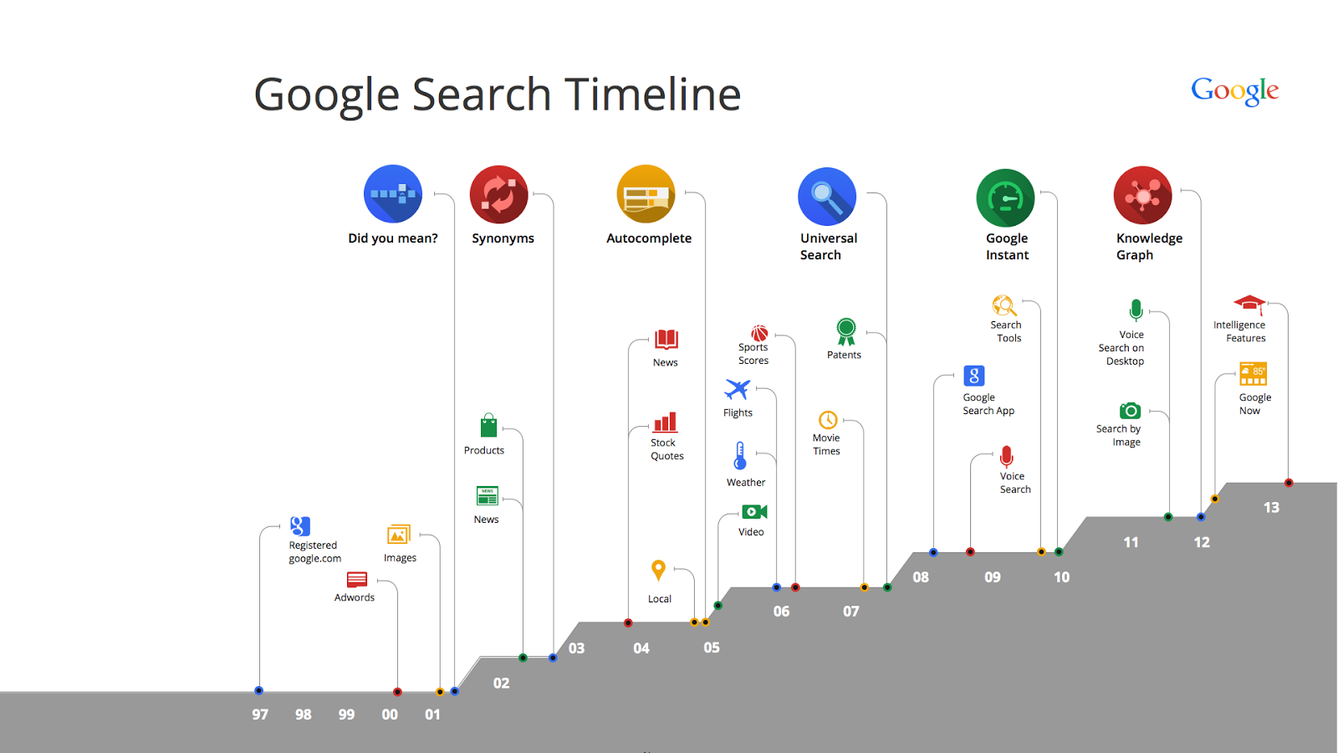
Major Breakthroughs in Data Science
Alan Turing
Knowledge Graph
1962
1950
2012
John W. Tukey
It is Google’s database of information
Google indexes and organizes information (known as graphing)
Notes:
Knowledge graphs showed a new way fo storing multiple different types of data in an interconnected manner that gave path to multiple data science use cases like personalisation, NLP, etc.
Do you know Google Images came into existence because people were searching for an image where Jennifer Lopez wore a Versace dress at Grammys in 2000?

Slide 6
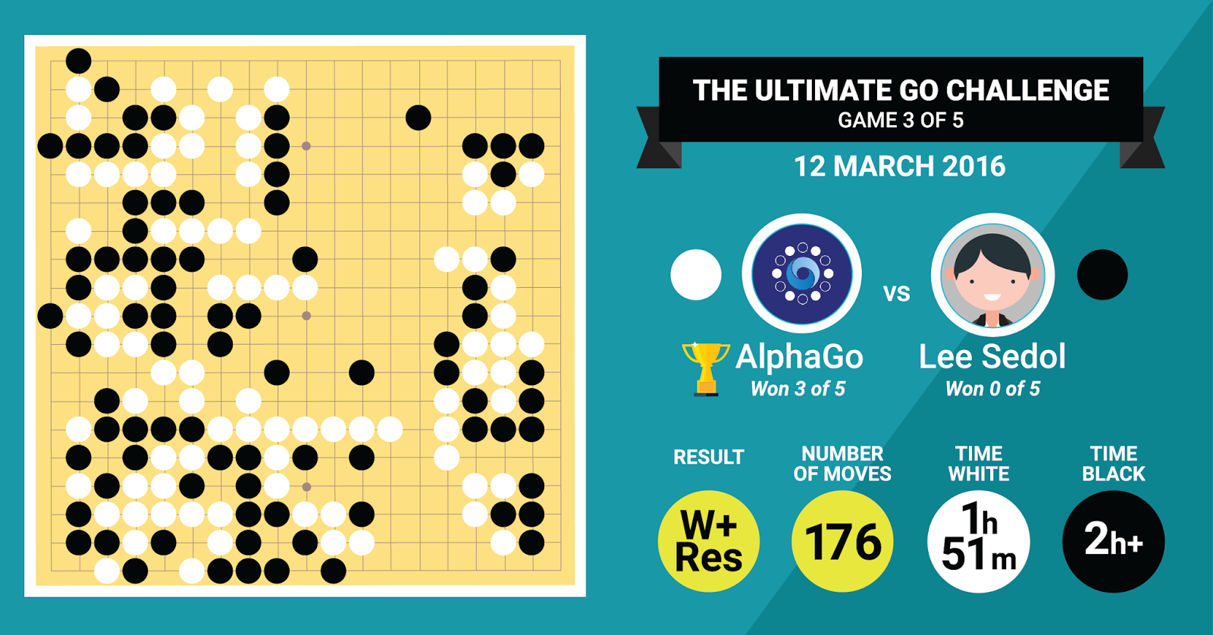
Major Breakthroughs in Data Science
Alan Turing
Knowledge Graph
1962
2016
1950
2012
John W. Tukey
AlphaGo
Designed to master the complex strategic game of Go
Uses self learning techniques in AI.
In March 2016, Alpha Go it beat Lee Sedol in a five-game match
Notes:
Next major breakthrough was when Alpha Go applied reinforcement learning to beat the world’s best Go player Lee Sedol by 4 - 1. And Lee Sedol was far better than the second best human player.
The latest breakthrough is Large language models powered ChatGPT.
Now that you have a decent idea of the data science landscape, let’s see how do we solve a business problem problem using data science?

Slide 7
The CRISP DM Framework
Business Understanding
Data Understanding
Data Preparation
Model Building
Evaluation
Deployment
Notes:
CRISP DM: Cross Industry Process Standard Process for Data Mining.
6 stage process that provides a framework to solve any business problem using Data Science techniques
Explain the different steps: (This section can be covered through multiple shorter examples from different industries)
Business Understanding:
People with the right business knowledge are able to take the right decision and hence, even if you are solving it using data science, business knowledge will play a critical role. This has led to the evolution of data driven or data backed business decision making.
Relate it to what they have seen in the first slide that domain knowledge is one of the important disciplines
Proper business knowledge not only helps in understanding the meaning or definition of data points but also helps eliminating approaches that didn’t work int he past.
Here, you finalise whether you are moving ahead with a Data Science based solution or not
Data Understanding:
Once, you have decided to proceed with a data science solution, you start by getting or collecting data from multiple places to one and understanding what it insights it provides.
You check the feasibility of the different solutions and work with the business and the data science team to narrow down the data science approach.
Data Preparation:
This approach involves removing the impurities in the data by performing various data cleaning techniques basis domain as well as statistical understanding. (please share some examples to cite importance of business knowledge: How will you replace the missing ages in the data? - By profile matching There are many data points where the age is 60. Why would that be? - System defaults for people who have not entered the age)
Here, you preparte data for whatever is the analysis you want to perform - can be just visualisaiton analysis with basic model building or hard core data science model building.
Model building: (Self explanatory)
Evaluation (Self explanatory, do mention that is not just evaluation from data science standpoint, but from business standpoint also. Give some example)
Deployment:
Model built is never deployment ready as experiment and deployment systems are very different.

Slide 8
The CRISP DM Framework
Business Understanding
Determine the business question and objective
Situation assessment
Determine the project goals
Project plan
Notes:
Start this by using the credit card example: (Through out the process, keep pointing out the different roles: DA, BA, DE, DS, MLE and the skillsets)
Explain the following: (The session has to very interactive where every question is addressed to the audience and the instructor shares the model answer)
How does a credit card work?
What are the revenue generation avenues for a credit card?
Then pose a problem that the business is facing losses
Evaluate the different reasons for the losses
Not good offerings, so less transactions, account maintenance fees becomes a problem
People default
Fraud transactions
Marketing is not good
Then give to the learners that Fraud is having the highest losses
What can be reasons for fraud?
Someone stole the card and user reported late
Someone copied the card details
Fraud Websites
How can this be solved?
Post facto by analysing the fraud transaction data points
Building a real time fraud detection system
You mention that building real time fraud detection makes sense as you will not incur losses at all times
Once you decide a method to solve and exactly which problem to tackle, you move to the next step: Project Planning and then data understanding
Summarize the two levels of problem solving done: (Converted the business problem to a data problem, formally define the business problem: Losses of Credit card department and the data problem: tackling fraud by building a fraud detection model)
Finding reasons for losses and evaluating which problem to tackle
Finding possible solutions for the problem

Slide 9
The CRISP DM Framework
Business Understanding
Data Understanding
Collect data
Explore data
Verify data quality
Notes:
Data Understanding is the following: (here, majorly DE and DA folks play a role)
What all data points are required to solve the problem? (What all data points are available for a credit card transaction: consumer side, client side and transaction level)
Where all are the data points present? (Talk about all the different types of data sources)
How and where will all the data points be collected and stored?
Various types of analysis is done to verify the truth and completeness of the data (basic data munging to get all dates in the same format, age, etc)
The database structure is also decided here (different normal forms, out of portion)

Slide 10
The CRISP DM Framework
Business Understanding
Data Understanding
Data Preparation
Data selection and cleaning
Feature engineering
Data Integration and formatting
Notes:
After having data at one place and having an understanding of all the data points that are available, you start analysing the data (majorly the role of a data analyst)
You’ll get many insights like
Which credit cards are having highest fraud?
Which consumers are being defrauded the most?
Which websites/ POS machines?
Which cities/ Pin codes?
Etc
Etc
Broadly categorize data into structured and unstructured data
You present the insights to the business (Note that the business folks are the ones who have worked with the project and there is some help that you get in understanding the reason and which data points to analyse to get the most meaning out of the analysis. Moreover they are the ones who have given you the budget, so regular updates is expected)
Whatever insights you get by analysis or visualisation, you decide what the next steps are - whether you have sufficient understanding to proceed with model building or no? Is modelling really required or feasible?
If modelling is a go ahead, you create features for the modelling (Give examples: gender, age brackets from age, avg salary in pin codes, 3M avg, 6M avg, number of times defrauded, etc., usually 200+ features are created) (Business understanding plays a very important role)

Slide 11
The CRISP DM Framework
Business Understanding
Data Understanding
Data Preparation
Model Building
Model Selection
Model Building
Model Assessment
Notes:
Use the features and create more features and try different types of modes
Highlight briefly what broadly are 2 types of models: (Use intuitive examples to explain)
Supervised (You know what exactly you need to predict)
Regression
Classification
Unsupervised (Customer segmentation: you don’t really know what kind of groups/ clusters will come up before hand)
Mention that they will learn about this later

Slide 12
The CRISP DM Framework
Evaluation
Evaluation
Evaluate Results
Determine Next Steps
Notes:
Evaluate performance of the different models basis the
Technical metrics or KPIs like accuracy, Recall, etc. in case of classification and RMSE, MAPE, etc in regression (mention that these, they’ll learn later on)
Business Metrics or KPIs: How much fraud transactions can be detected? How much losses can be reduced?
Decide how to deploy the model

Slide 13
The CRISP DM Framework
Evaluation
Deployment
Deployment
Monitoring and maintenance
Final report
Notes:
Highlight how the fraud detection model works:
Transactions take 3- 4 seconds to get approved, especially when it is large ticket transaction
POS/ Website sends information to bank server
Fraud model runs on the transaction and gives a go ahead/ no go
At times, the transaction deos not go through at the first go and you get a confirmation call from the customer service confirming the transaction
So, naturally the model needs to be very fast and it should be compatible with the bank’s tech infrastructure
So, you need to convert the Python model into some language that satisfies the above requirements
Also, briefly touch CI/ CD that is important for any ML model/ software system

Slide 14
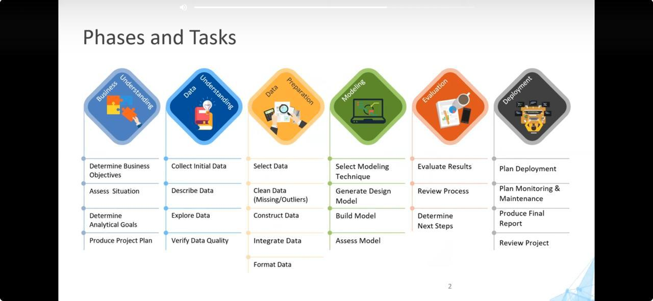

Slide 15
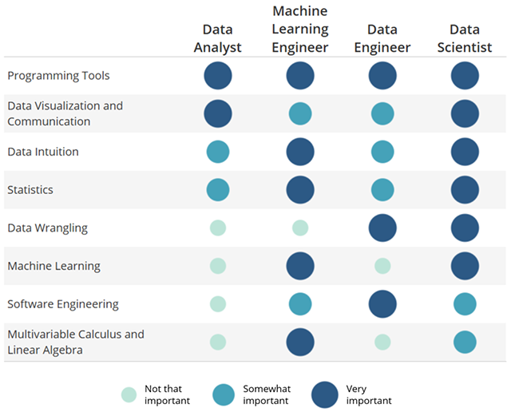
{
Business and Data Understanding
{
Data Preparation
{
Model Building
Evaluation
{
{
Deployment
Notes:
Summarize the whole case study and discuss the above slide on the different roles and the skill set required. Business Analyst is not there. So, that can go as a question for the learners: make the map for a business analyst role against the different skillset

Slide 16
Let’s take another case study

Slide 17
Ecommerce Company like Amazon.in is not having revenue growth in electronic commerce.
How all does Amazon.in generate revenue?

Slide 18
Ecommerce Company like Amazon.in is not having revenue growth in electronic commerce.
How all does Amazon.in generate revenue?
Commission on Product Sales
Subscription Services
Advertisement
Financial Services
Value Added Services
Membership programs
Data Monetisation

Slide 19
Ecommerce Company like Amazon.in is not having revenue growth in fashion segment.
What could be reasons for the fashion segment revenue to not grow?

Slide 20
Ecommerce Company like Amazon.in is not having revenue growth in fashion segment.
What could be reasons for the fashion segment revenue to not grow?
Number of orders or customers is not growing
Changing customer preferences: Latest fashion trends are not available
Strong competition: Pricing differences with respect to competitors
Quality of products delivered is not good
Losses in return: High return rates and fraud

Slide 21
Ecommerce Company like Amazon.in is not having revenue growth in fashion segment.
Business wants to tackle the problem of “Changing customer preferences: Latest fashion trends are not available”.
Which competitor do you see is doing this better? And how?
Notes:
Talk about Myntra. They have segmented the customers for easy understanding: (Check the Myntra App and find differentiations)
Occasion: Active wear, casuals, party, etc, etc.
Myntra, fwd(GenZ), Luxe
Men, Woman, Kids
Capturing on the Sneaker Trend

Slide 22
How can you address “Changing customer preferences: Latest fashion trends are not available”?
Notes:
Market Research and Trend Analysis: Regularly conduct market research and trend analysis to stay updated on the latest fashion trends and understand shifting consumer preferences. Utilize tools like social media monitoring, trend forecasting services, and customer feedback to identify emerging trends.
Collaborations and Partnerships: Collaborate with designers, influencers, and other brands to co-create exclusive collections or limited-edition products based on the latest fashion trends. Partnering with trendsetters can help increase brand visibility and attract fashion-forward customers.
Data-Driven Merchandising: Leverage data analytics and sales insights to inform merchandising decisions. Monitor sales performance, customer feedback, and market demand to identify popular trends and adjust inventory accordingly.
Fast Fashion Strategies: Implement fast fashion strategies such as frequent product releases, small-batch production, and just-in-time inventory management to quickly introduce new styles and capitalize on emerging trends.
Customer Engagement and Feedback: Engage with customers through social media, surveys, and feedback channels to understand their preferences and gather insights on the types of products they want to see. Actively solicit feedback and involve customers in the product development process.
Responsive Marketing Campaigns: Develop marketing campaigns that highlight the latest fashion trends and showcase how your products align with current styles. Utilize channels like social media, email marketing, and influencer partnerships to amplify your message and reach fashion-conscious consumers.

Slide 23
How can you address “Changing customer preferences: Latest fashion trends are not available”?
Regularly conduct market research and trend analysis
Understand your customers
Collaborate with designers, influencers, and other brands to co-create exclusive collections or limited-edition products
Fast Fashion Strategies
Responsive Marketing Campaigns
Notes:
Market Research and Trend Analysis: Regularly conduct market research and trend analysis to stay updated on the latest fashion trends and understand shifting consumer preferences. Utilize tools like social media monitoring, trend forecasting services, and customer feedback to identify emerging trends.
Collaborations and Partnerships: Collaborate with designers, influencers, and other brands to co-create exclusive collections or limited-edition products based on the latest fashion trends. Partnering with trendsetters can help increase brand visibility and attract fashion-forward customers.
Data-Driven Merchandising: Leverage data analytics and sales insights to inform merchandising decisions. Monitor sales performance, customer feedback, and market demand to identify popular trends and adjust inventory accordingly.
Fast Fashion Strategies: Implement fast fashion strategies such as frequent product releases, small-batch production, and just-in-time inventory management to quickly introduce new styles and capitalize on emerging trends.
Customer Engagement and Feedback: Engage with customers through social media, surveys, and feedback channels to understand their preferences and gather insights on the types of products they want to see. Actively solicit feedback and involve customers in the product development process.
Responsive Marketing Campaigns: Develop marketing campaigns that highlight the latest fashion trends and showcase how your products align with current styles. Utilize channels like social media, email marketing, and influencer partnerships to amplify your message and reach fashion-conscious consumers.

Slide 24
How can you address “Changing customer preferences: Latest fashion trends are not available”?
Business feels that there are some types of customers that are not coming to the site to shop, hence, they wish to leverage data science to understand the customers and their preferences.
The rest of the solutions are the outcomes of the insights from the above understanding.

Slide 25
How can you address “Changing customer preferences: Latest fashion trends are not available”?
What all questions will you find answers to?
What are the personas of the customers?
Which personas are not coming?
Which personas of customers have gradually or completely dropped off?
Which types of personas buy what types of products?
How do you track fashion trends?
What is the correlation between fashion trends and the corresponding products sold?
Notes:
Highlight that these are only some of the questions that act as hypotheses or guiding principles for further research and analysis.
What are the personas of the customers? -> Give examples of personas as combination of gender, age, city, etc etc, can be boomers, millenials, genz, gen alpha, etc.
Which personas are not coming? -> May be GenZ folks are not buying from Amazon.in
Which personas of customers have gradually or completely dropped off?
Which types of personas buy what types of products?
How do you track fashion trends? -> Track twitter/ instagrams of all actors, fashion labels, influencers, via APIs, web scraping
What is the correlation between fashion trends and the corresponding products sold?
Also, that here, you have converted the business problem to data problem.

Slide 26
How can you address “Changing customer preferences: Latest fashion trends are not available”?
What data points are available?
Notes:
1. Personal Information:
- Name
- Age or birth date
- Gender
- Contact details (email, phone number)
- Shipping and billing addresses
2. Account Details:
- User ID
- Account creation date
- Membership status (e.g., regular, premium, VIP)
- Preferences and settings
3. Behavioral Data:
- Browsing history (products viewed, pages visited)
- Search queries within the site
- Engagement with marketing content (emails opened, links clicked)
- Social media interactions or references
4. Transaction Data:
- Purchase history (products bought, quantity, price)
- Payment methods used
- Shopping cart items (including abandoned carts)
- Returns and exchanges history
- Coupon and discount usage
5. Device and Usage Data:
- Device type (mobile, tablet, desktop)
- Operating system and browser type
- IP address and geographical location
- Date and time of visits
- Session duration and activity
6. Customer Service Interactions:
- Support tickets and chat logs
- Customer feedback and product reviews
- Call logs and email correspondences
7. Loyalty and Rewards Data:
- Points earned and redeemed
- Participation in loyalty programs
- Referral history and rewards
8. Social Media Data:
- Social media profiles linked to the account
- Likes, shares, and comments on social media channels
- Social media referrals and influences
9. Preference and Interest Data:
- Wishlist items
- Product ratings and reviews
- Survey responses and feedback
10. Financial data related to Amazon pay
11. Market Segment Information: (can skip this)
- Customer segmentation classifications (e.g., based on spending habits, product preferences)
- Lifetime value estimates
- Risk of churn
End the case study here that there were multiple data problems that you can solve which is then prioritized and worked upon and we won’t go into depths as it is currently out of scope. The idea is the following is “How do you convert the business problem to a data problem by asking questions?”
Understand business
What are possible reasons or problems?
How to find data driven solutions to the problems?
What are possible hypotheses you wish to test?
Also, very important to highlight that many of the data problems in the previous slide seem analysis and not modelling ones. But it may happen, in the course of time that in the end up creating a complex ML solution like sales forecasting, propensity model for a customer buying the product, product recommendation systems, etc (Please touch upon this, how the data problems may result into these ML solutions)

